Slide 1



ViTi
Your personalized financial management webapp
We are here to help and guide VIT students manage their finances with ease, From analyzing your monthly budget and everyday expenses, we can help you manage your savings and remain underbudget!.

Slide 2

Introduction
Our Personal Finance Tracker Web App simplifies money management by helping users track expenses, set budgets, and visualize their financial health. With an intuitive interface, users can easily log daily spending, create personalized budgets, and monitor their progress toward financial goals. This app empowers users to take control of their finances and achieve greater financial stability.

Slide 3
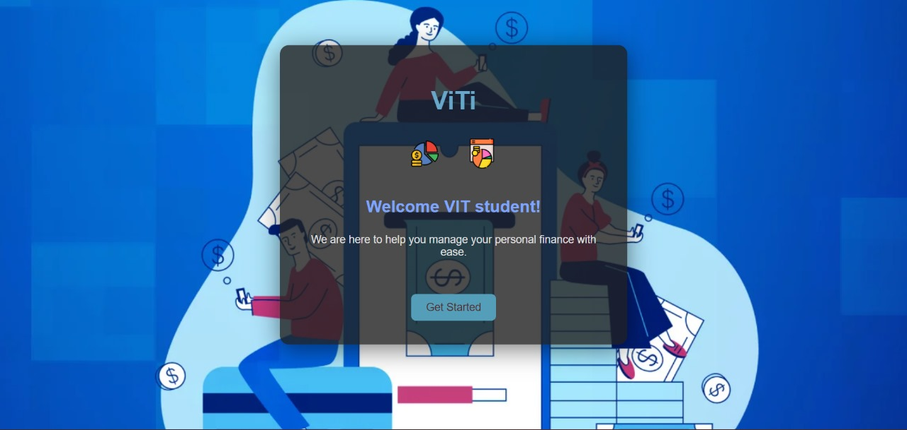
Page1- HOME PAGE
Your Financial management journey starts here!

Slide 4
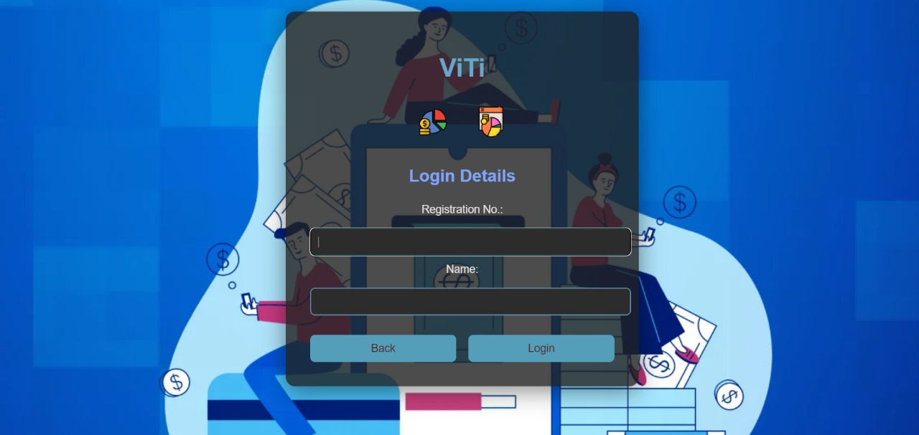
PAGE-2-Login
Fill in your login credentials.

Slide 5
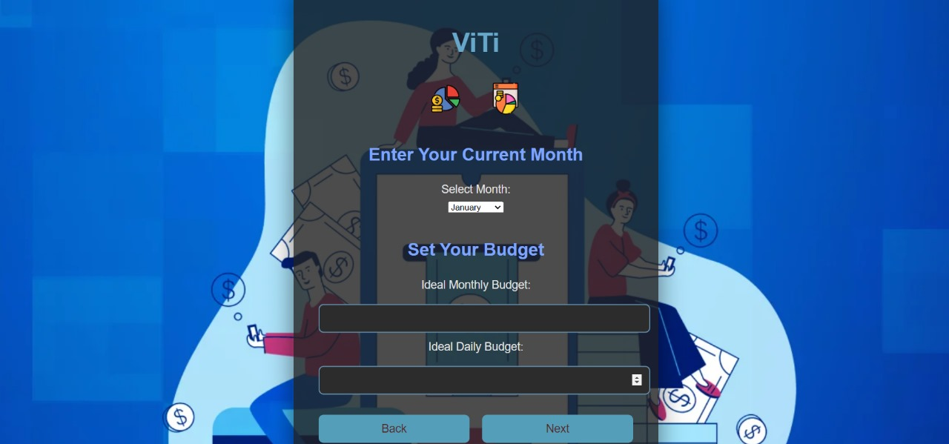
PAGE-3-Set Budget
Select the month for which you want to set your budget
Enter your monthly budget and daily budget

Slide 6
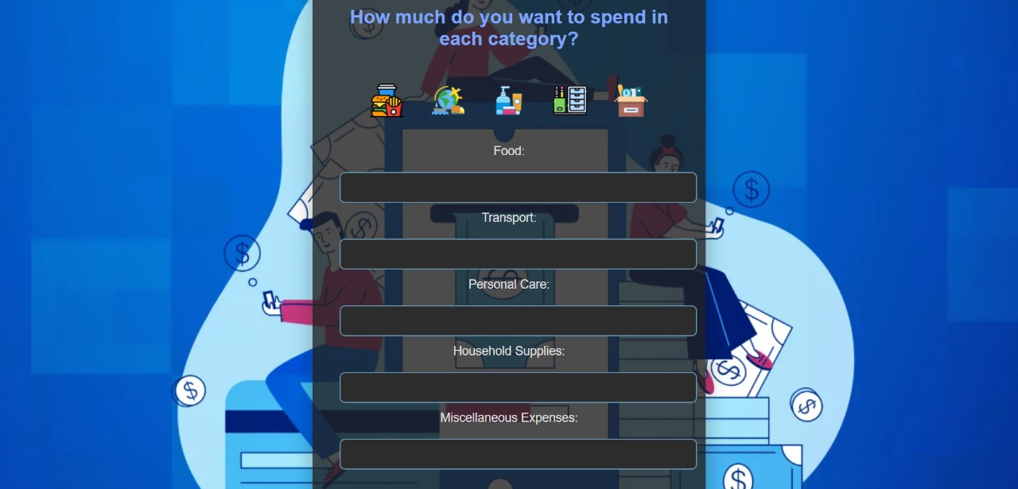
Page-4- Ideal Expenses
Now enter your ideal spendings for each day of the month in the following categories of food, transport, household supplies.
If any of your spendings do not come under these, fill them in miscellaneous category.

Slide 7
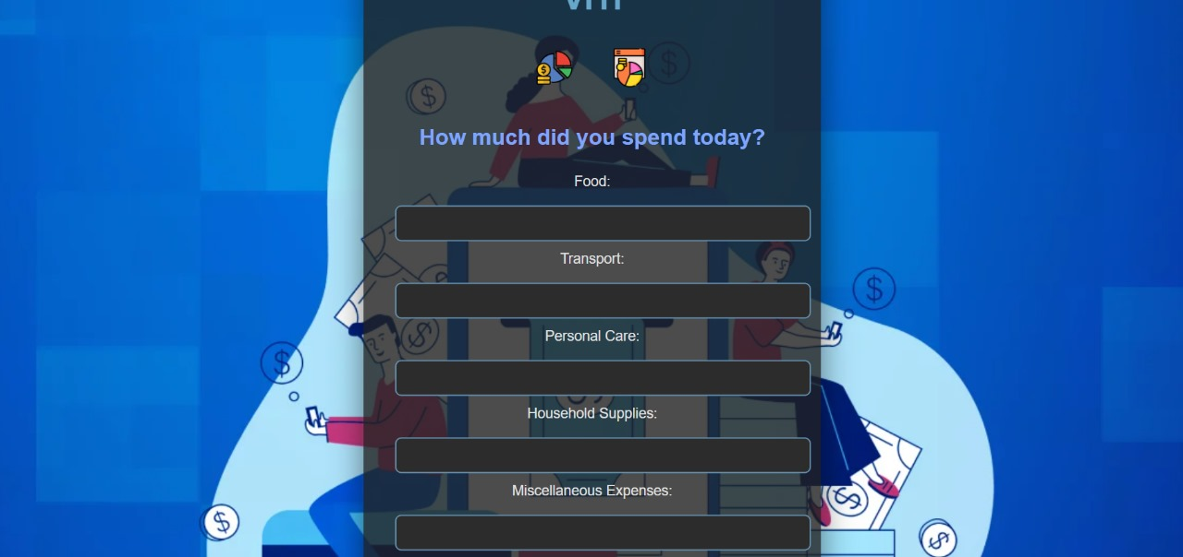
Page-5- Actual expenses.
Do the same for actual spendings on day to day basis

Slide 8
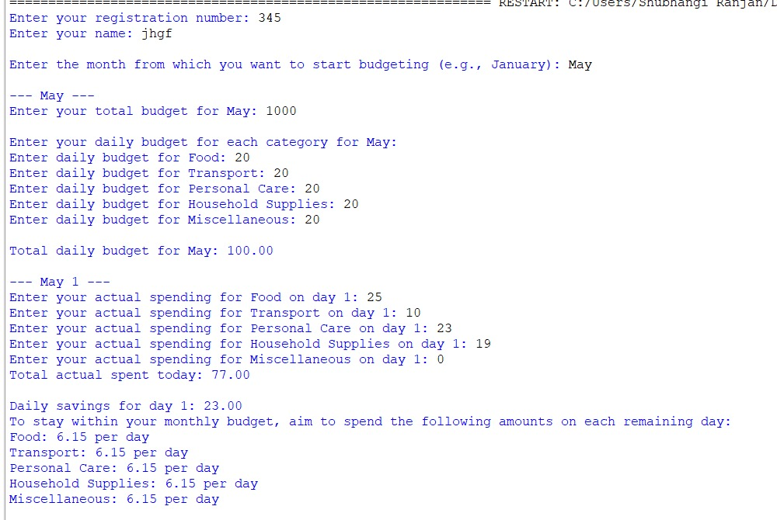
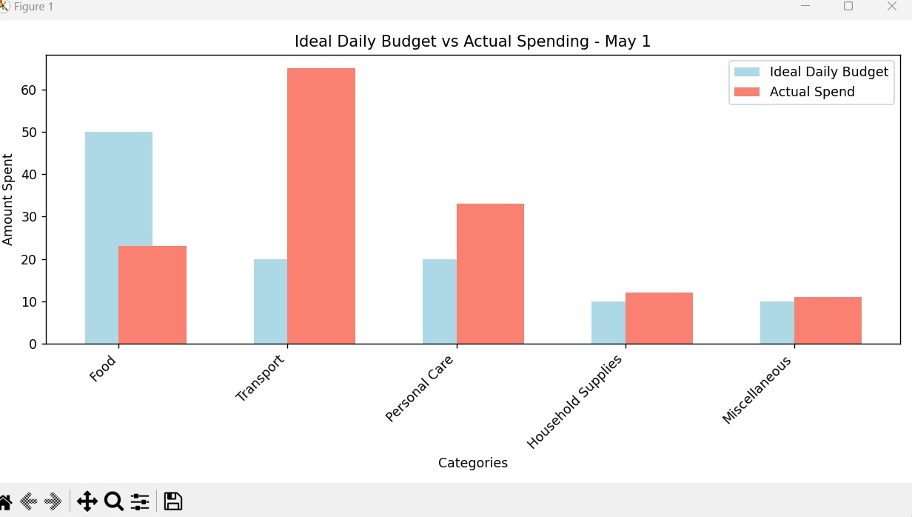
Page 6- The Result page
Will show you your:
Daily budget- by adding all ideal expenses in each category.
Daily expense - by adding your actual expenses for the day.
Daily savings- by comparing your ideal and actual expenses.
Suggestions to save for upcoming days- Give you personalized expenses for the upcoming days so you stay under your monthly budget.
Bar graph- So you can visually evaluate your progress.

Slide 9



We hope you have a progressive financial month!

Slide 10




Thank you

